Slide 1
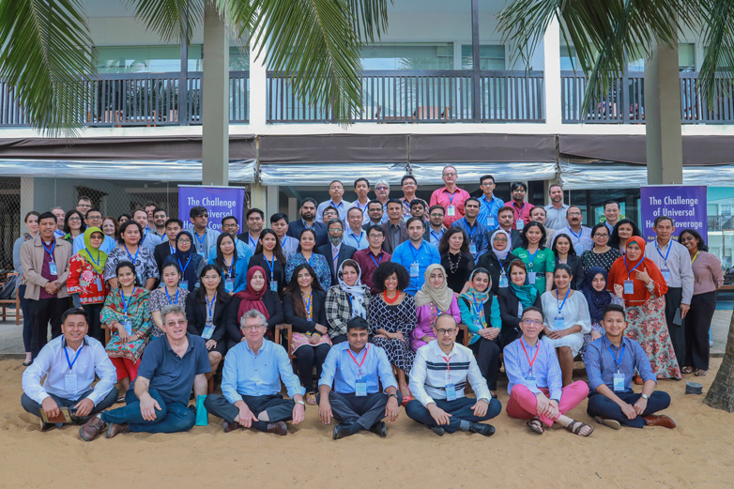






Armenia Flagship Course on Health Systems Strengthening: Moving to UHC in Times of Transition
Objectives
Improve lingua franca for health systems, in a systematic way
Foster a more evidence-based approach to implementing change
Apply the framework on concrete health reform issues in Armenia, by analyzing pros and cons of different options
Strengthen development partner coordination and cooperation through capacity strengthening
Engage: less teaching, less prescription, more professional interaction
Flagship Course on Health Systems
Hundreds of deliveries over the last 20+ years, 80+ countries with 30,000 participants
Common framework and language to systematically analyze, discuss and design policies for health systems strengthening and UHC, also a Community of Practice
Evolving reflecting changing needs, e.g. emergence of UHC as overarching objective, transition challenges
Links technical dimensions with ethical and political economy
A partnership – global agencies working better together

Slide 2
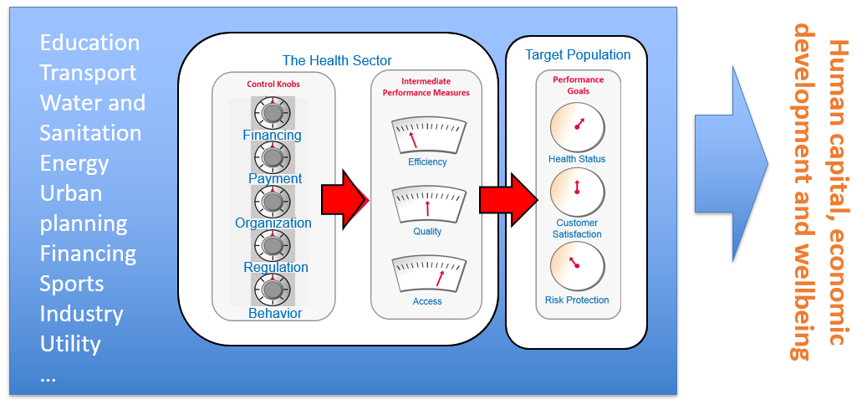
From Control Knobs to Performance in Policy Cycle
TECHNICAL
Adapted from Reich, M. et al Lessons learned from 20 years of Capacity Building for Health Systems Thinking. Health Systems and Reforms, 2106.

Slide 3

Getting Started by Breaking Ice
In tables, introduce yourselves to your table colleagues
Count the total years of table members experience in health reform
Come up with one expectation per table for the course
Nominate a colleague to introduce people at the table to whole group by first name and affiliation; amount of experience, and expectation
5 minutes to prepare, 1 minute to present per table

